Slide 1
Ray Tracing with Triangle Geometry
Eric Farmer
edf63@msstate.edu
December 6, 2019

Slide 2
Presentation Overview
Introduction
Implementation
Issues
Improvements

Slide 3
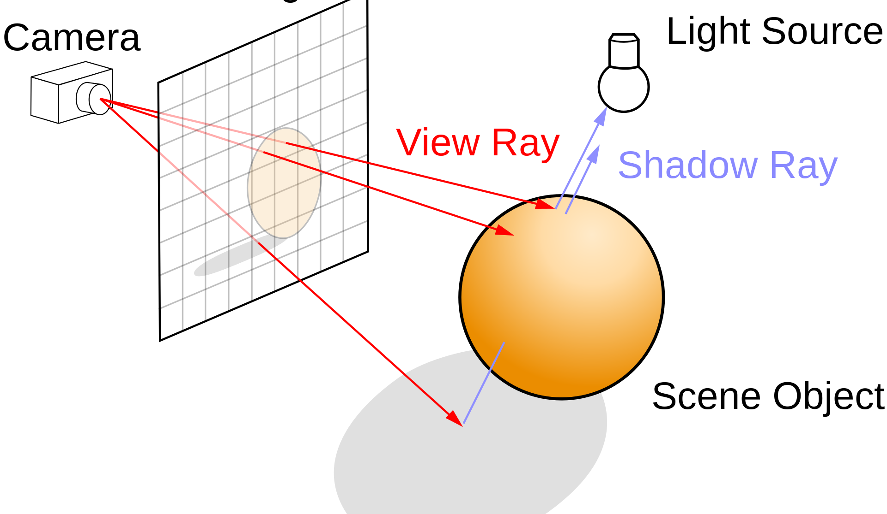
Fundamentals of Ray Tracing
Introduction
Implementation
Issues
Improvements
[3]
For each pixel collected from the image plane, cast a ray through that pixel and determine its interaction with the scene.

Slide 4
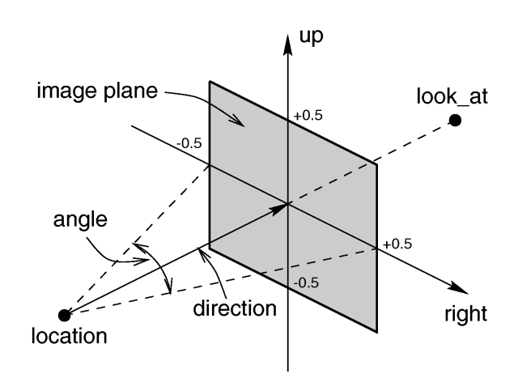
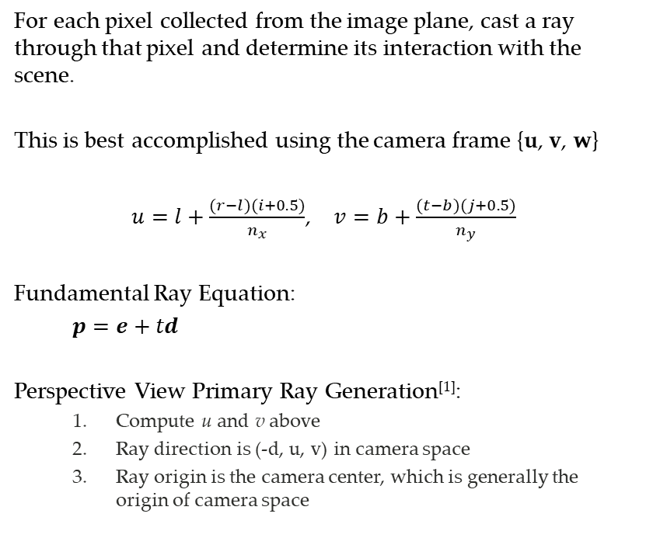
Ray Generation
Introduction
Implementation
Issues
Improvements
For each pixel collected from the image plane, cast a ray through that pixel and determine its interaction with the scene.
This is best accomplished using the camera frame {u, v, w}
$u=l+\frac{(r−l)(i+0.5)}{n_{x}}$, $v=b+\frac{(t−b)(j+0.5)}{n_{y}}$
Fundamental Ray Equation:
$p=e+td$
Perspective View Primary Ray Generation^{[1]}:
Compute u and v above
Ray direction is (-d, u, v) in camera space
Ray origin is the camera center, which is generally the origin of camera space
[4]

Slide 5
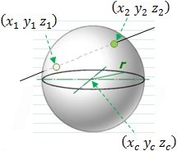
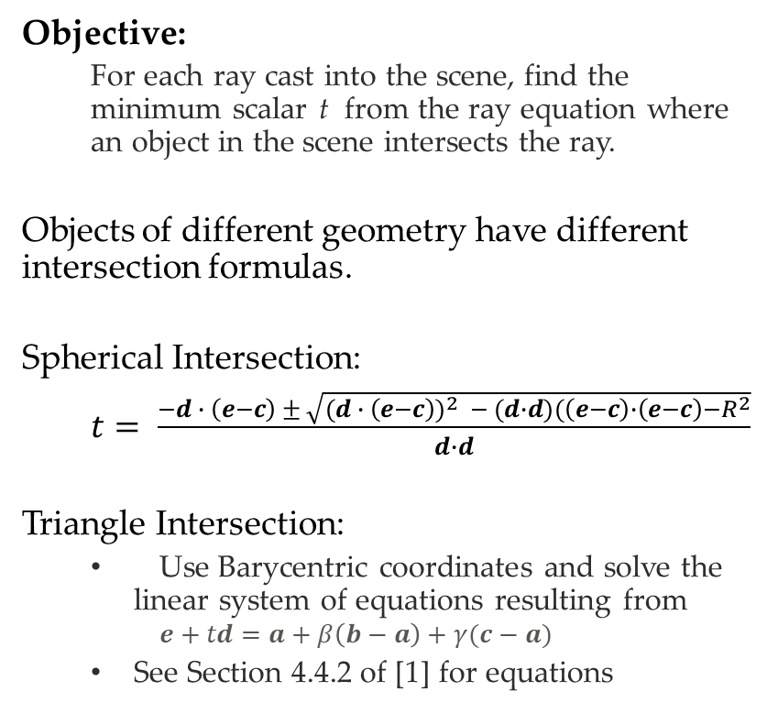
Ray-Object Intersections
Introduction
Implementation
Issues
Improvements
Objective:
For each ray cast into the scene, find the minimum scalar t from the ray equation where an object in the scene intersects the ray.
Objects of different geometry have different intersection formulas.
Spherical Intersection:
$t= \frac{−d ∙ \left(e−c\right) ± \sqrt{{(d ∙ \left(e−c\right))}^{2} − (d∙d)(\left(e−c\right)∙\left(e−c\right)−R^{2}}}{d∙d}$
Triangle Intersection:
Use Barycentric coordinates and solve the linear system of equations resulting from
$$e+td=a+β\left(b−a\right)+γ(c−a)$$
See Section 4.4.2 of [1] for equations

Slide 6
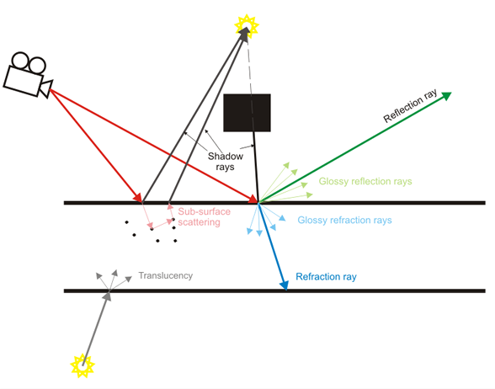
Shading with Ray Tracing
Introduction
Implementation
Issues
Improvements
[5]
The color of a pixel is determined by the interactions of various rays at a point of intersection.

Slide 7

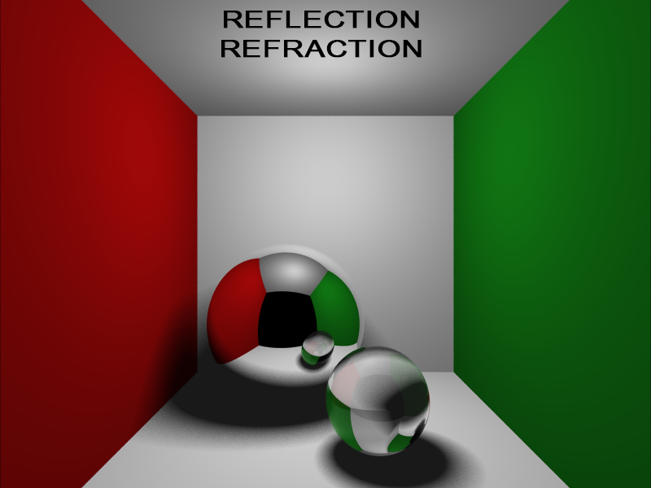
Shading Model
Introduction
Implementation
Issues
Improvements
Objective:
For each pixel, determine the light contribution of each ray intersection along the path to the light source
Standard Blinn-Phong Model
Reflection Rays
Refraction Rays
Transparency Rays
Soft Shadows
Depth of Field
Glossy Reflection
Motion Blur
[6]

Slide 8
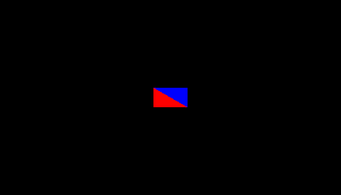
Implementation
Introduction
Implementation
Issues
Improvements
Stage 1 - Render something

Slide 9
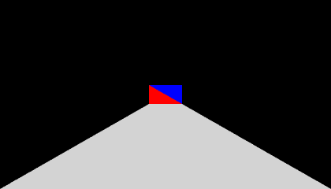
Implementation
Introduction
Implementation
Issues
Improvements
Stage 2 – Add some multisampling anti-aliasing

Slide 10

Implementation
Introduction
Implementation
Issues
Improvements
Stage 3 – Render the box to hold the car

Slide 11

Implementation
Introduction
Implementation
Issues
Improvements
Stage 3 – Modified to Cornell Box with ambient shading only

Slide 12

Bug Tracker
Introduction
Implementation
Issues
Improvements
Incorrect implementation of lighting model
Verifying MINI model loading and transformation
Missing implementation for bounding box intersection

Slide 13

Issues
Introduction
Implementation
Issues
Improvements
The current implementation is not doing Blinn-Phong lighting correctly

Slide 14
Improvements
Introduction
Implementation
Issues
Improvements
For this assignment:
Fix Blinn-Phong lighting model
Add reflections
Add bounding box intersection test
Other improvements:
Spatial search structures
Multithreaded implementation
More complex lighting

Slide 15
References
Marschner, Stephen Robert, and P. Shirley. Fundamentals of Computer Graphics. 4th ed., CRC Press, Taylor & Francis Group, 2016.
Redmon, Joe. “Senior Thesis.” May 2011
https://en.wikipedia.org/wiki/Ray_tracing_(graphics)
https://www.povray.org/documentation/view/3.6.1/246/
https://docs.chaosgroup.com/display/VRAY3MAYA/Basic+Ray+Tracing
http://www.tenghaowang.com/computergraphics

Slide 16

Questions
Thank you for listening

